Slide 1
CGB1201 – JAVA PROGRAMMING
Department of Artificial Intelligence and Data Science
Academic Year: 2024 – 2025 (Odd Semester)
Register Number : 2303811724321070
Name : MOHANAVEL K
Year : 2nd
Semester : 3rd
Section : B
Date : 3/12/2024

Slide 2
Title of the Project
SIMPLE BANKING APPLICATION

Slide 3
Problem Identification
Managing financial transactions efficiently is crucial for both banks and account holders. Traditional banking systems often involve manual paperwork, which is time-consuming and prone to human error. Even in digital banking, users face challenges such as keeping track of their transaction history, verifying sufficient funds for withdrawals, and accessing simple banking services with ease. This project aims to address the following key problems:
How to implement a simple, user-friendly system for depositing and withdrawing funds?
How to ensure that the user cannot withdraw more than their available balance?
How to maintain an accurate and accessible record of all transactions?

Slide 4
Objective
The objective of this project is to design and develop a simple Bank Management System that allows users to:
Deposit funds into their accounts.
Withdraw funds, ensuring they have a sufficient balance to make the withdrawal.
Maintain a transaction history, showing all deposits and withdrawals for each account. The system will ensure ease of use while providing essential functionalities, making banking more transparent and efficient for users.

Slide 5
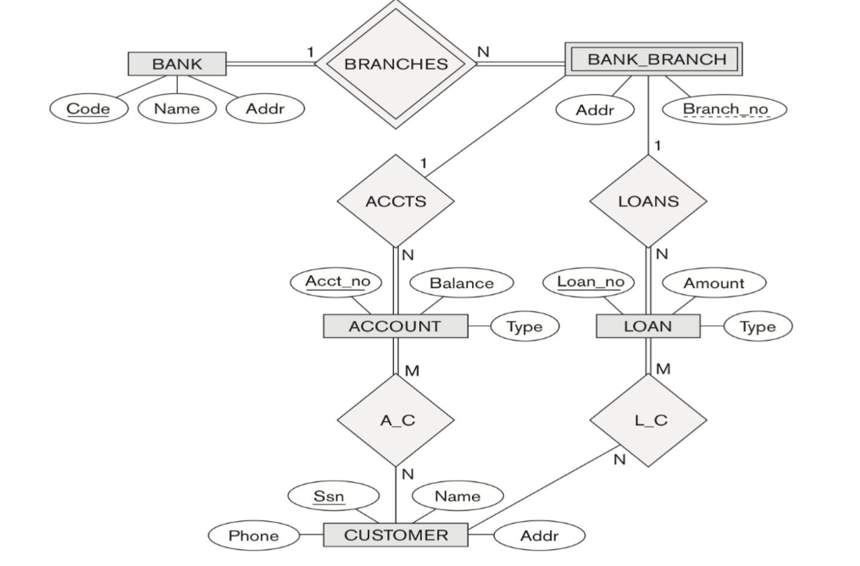
Proposed Architecture

Slide 6
Java Programming - Concepts Used
The following Java programming concepts are utilized in this project:
Object-Oriented Programming (OOP): Classes and objects represent accounts, transactions, and the overall system.
Exception Handling: Used to manage errors such as insufficient funds and invalid input.
File Handling: Ensures transaction records are stored persistently for future retrieval.
Multithreading (if applicable): For concurrent operations such as processing multiple transactions simultaneously.
Collections Framework: Used to manage and store data like transaction history dynamically.

Slide 7
List of Modules
Account management module
Deposit management module
Withdraw management module
Transaction history module
File handling module

Slide 8
Module Description
Account Management Module:Handles account creation, storing user details such as name, account number, and initial balance.
Deposit Module:Enables users to deposit funds into their account while updating the balance.

Slide 9
Module Description
Withdrawal Module:Allows users to withdraw funds, ensuring sufficient balance and recording the transaction.
Transaction History Module:Displays the history of transactions, including deposits and withdrawals.
File Handling Module:Manages persistent storage of account details and transaction records using file I/O operations.

Slide 10
Module Description (Cont..)
The modular structure also allows for future growth and adaptability, enabling easy incorporation of advanced features like fund transfers, loan management, and multi-currency support. With its focus on security, including validation and data encryption, the application ensures user data integrity and confidentiality. Overall, the Simple Banking Application serves as a solid foundation for exploring more complex financial systems, providing a comprehensive, secure, and expandable solution for personal or educational use. Its design exemplifies the importance of modularity, clear architecture, and practical application of programming concepts in software development.

Slide 11

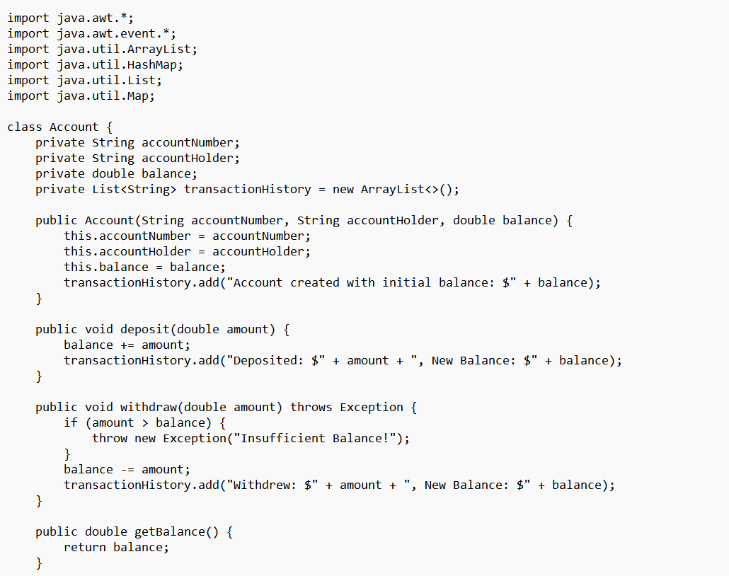
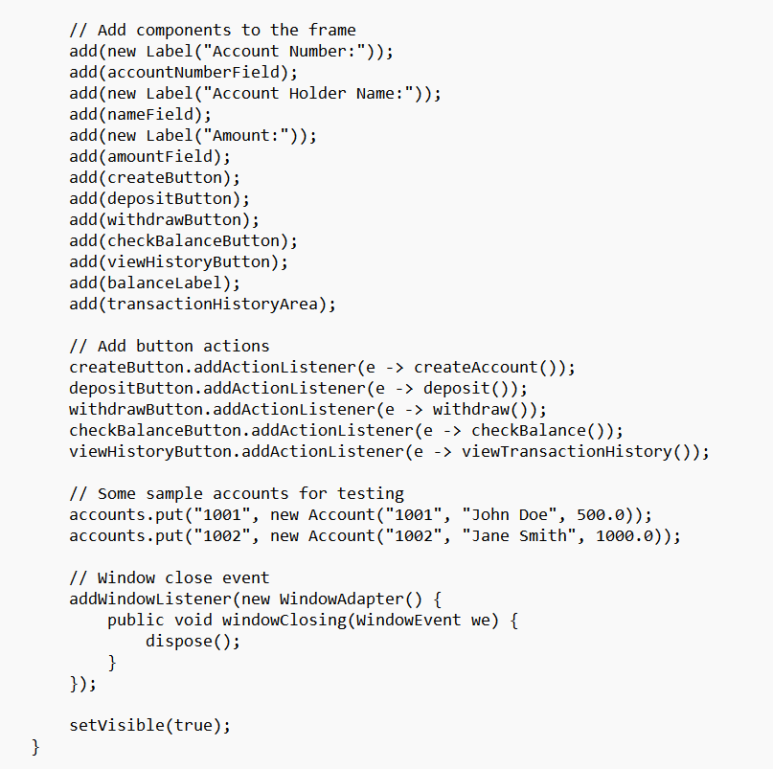
SOURCE CODE

Slide 12
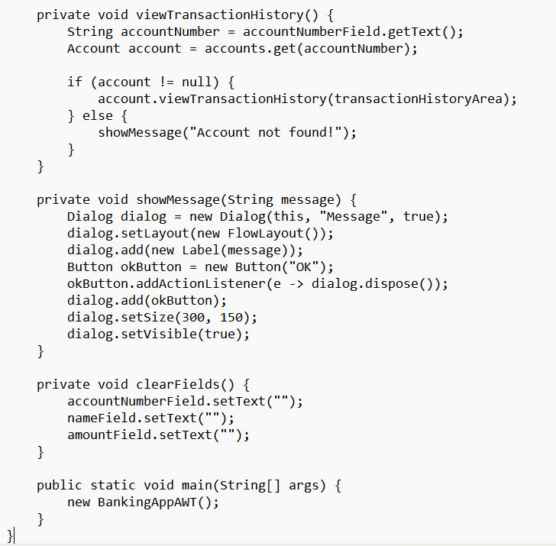
SOURCE CODE

Slide 13
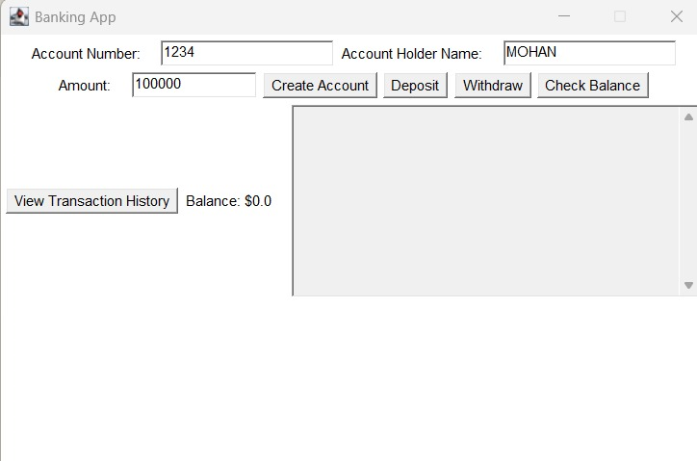
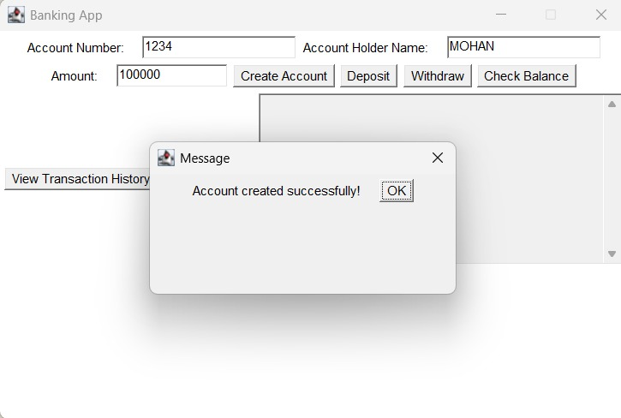
Results and Discussion

Slide 14
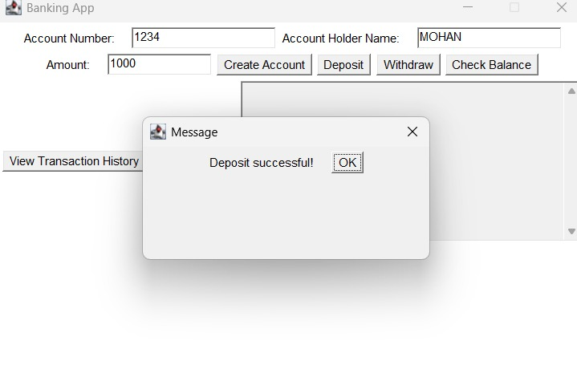
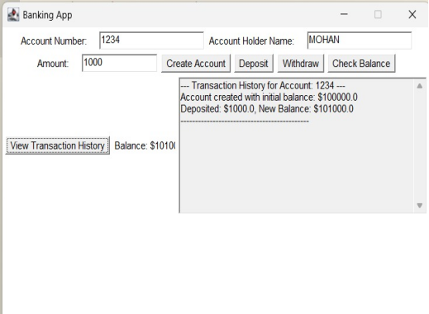
Results and Discussion

Slide 15
Conclusion
The Simple Banking Application, built upon a modular architecture, provides a robust, user-friendly platform for managing essential banking operations like account creation, deposits, withdrawals, and transaction history tracking. Each module, from Account Management to File Handling, plays a distinct yet interconnected role, ensuring the system operates seamlessly while maintaining data accuracy and security. By employing a layered design approach, the application separates concerns effectively, enhancing maintainability and scalability. The integration of Java programming concepts such as object-oriented principles, exception handling, and file operations ensures the application is both efficient and reliable, making it suitable for real-world banking scenarios.

Slide 16
Thank You

